Slide 1
Insitu Visualization and Analysis of Ion Accelerator Simulations using Warp and VisIt
O. Ruebel, B. Loring, J. Vay, D. P. Grote, R. Lehe, S. Bulanov, H. Vincenti, W. Bethel

Slide 2
WarpIV
a state of the art insitu vis and analysis application
couples Warp laser plasma simulation to insitu visualization tools
provides optimized i/o and analysis
provides domain specific functionality, eg. filters, Yee cell support
written in a mix of Python and C++. User only sees the Python side.
provides a structured/uniform interface to Warp, includes a number of example.
can be used “live” or in batch
runs on any system from laptop to Cray SuperComputer

Slide 3
Why insitu? What are the challenges?
increase temporal resolution and at the same time realize I/O reduction
rendering, reduces problem sized data to image sized data
fast, small, serial I/O, doesn’t impact file system.
but hard to get it right without a lot fiddling and fine tuning
“extracts”, derived quantities, reduced geometry etc
focused analysis, do exactly what you need, write exactly what you need
often smaller, but not always
different I/O properties than simulation itself
render it later, so you can get the best result

Slide 4
Science of Ion beam acceleration
can be used in many applications
including cancer therapy
potential advantages cancer therapy
precise control over depth at which energy is deposited results in less tissue damage
relatively compact and cheap
An active area of research, simulations are used to develop and prove theory and will eventually model experimental apparatus
Heavy ions,
accelerated
by the light
pressure
Electrons, expelled from the focal spot
Laser Pulse
Protons, accelerated
by the moving
charge separation field
Foil
simple idea: use a laser to create a plasma. charge separation accelerates ionized hydrogen
S. S. Bulanov, et al. “Accelerating monoenergetic protons from ultrathin foils by flat-top laser pulses in the directed-coulomb-explosion regime,” Phys. Rev. E, vol. 78, p. 026412, Aug 2008.

Slide 5
Cost vs Benefit of 3D Simulations
Are 2D simulations of the ion beam accelerator good enough?
2D simulations are often used in theoretical development
computational costs are low
2D datasets are small
easy to analyze on a workstation using familiar tools
3D simulations more accurately model the situation
very computationally expensive
very large datasets are produced
analysis is challenging, need parallel vis tools, and supercomputing
O. Rubel et al, “In situ Visualization and Analysis of Ion Accelerator Simulations using Warp and VisIt”, IEEE CG&A, SPECIAL ISSUE ON HIGH PERFORMANCE VISUALIZATION AND ANALYSIS, SEPTEMBER 2015 (submitted)

Slide 6
Run parameters
900^2 x 1800 mesh
~2 B particles
1,069,251,640 electron
809,557,568 carbon
259,694,072 proton
6400 time steps
Vis & analysis every 100 steps

Slide 7
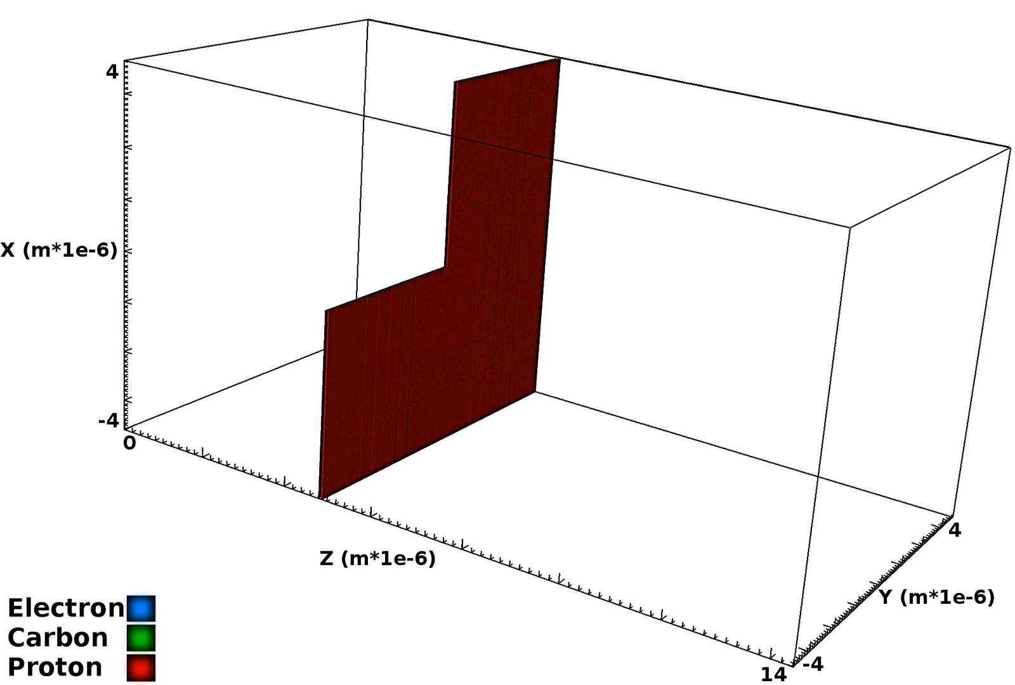
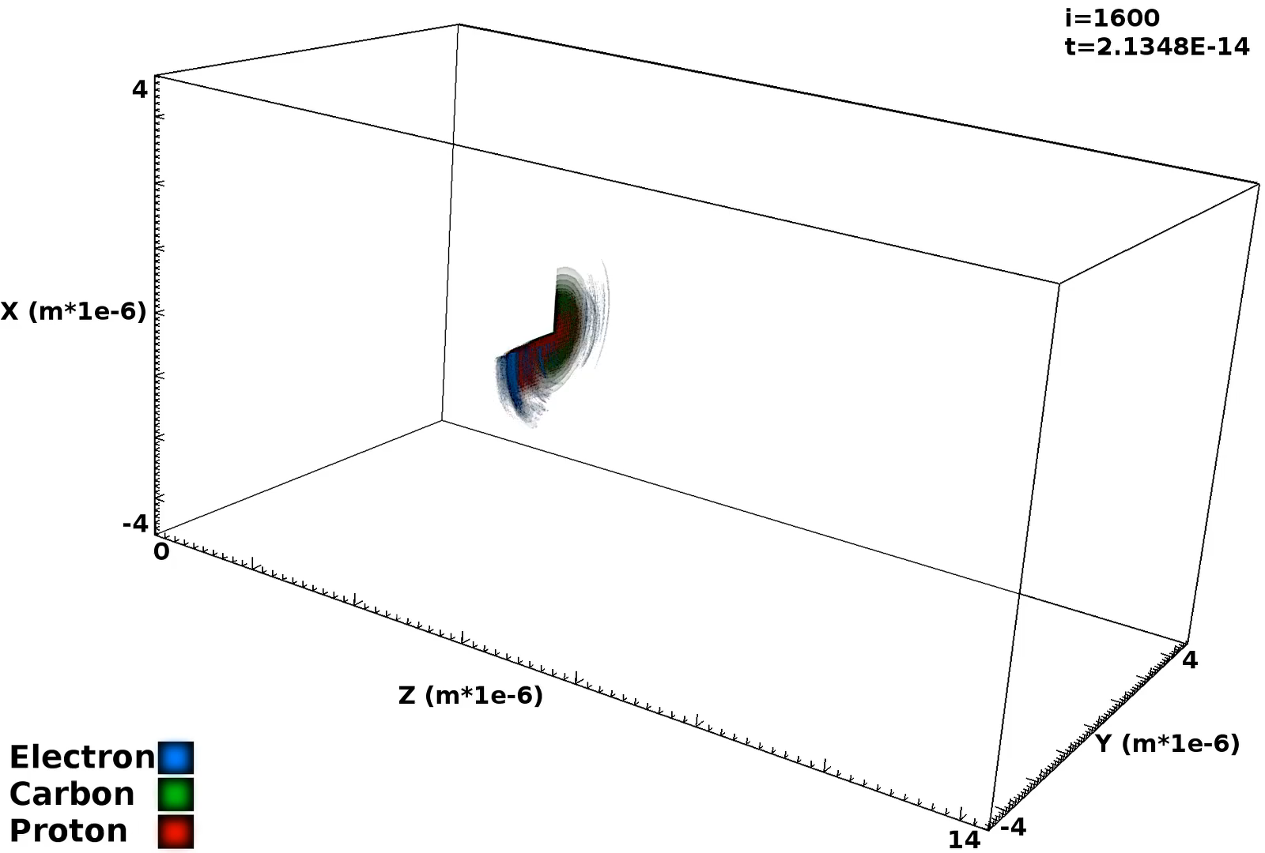
Visualization: Iso-surfaces
Particle Density
Kinetic Energy
Notes:
renderings of the 3d run. insitu rendering is challenging. could look better! but massive data reduction going from problem sized data to images.

Slide 8
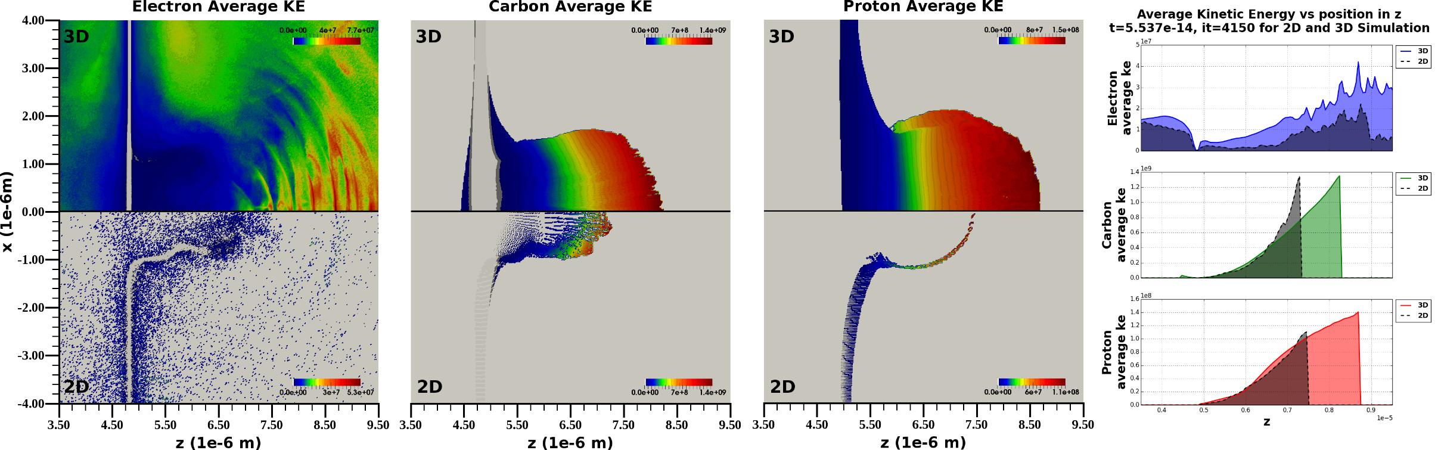
Are 2D simulations good enough?
Notes:
Maybe! But there are some substantial differences that suggest 3D is important in this application. in 2d beam is narrower and nearer the source, you may not be able to do accurate targeting or device design using 2d sims.

Slide 9
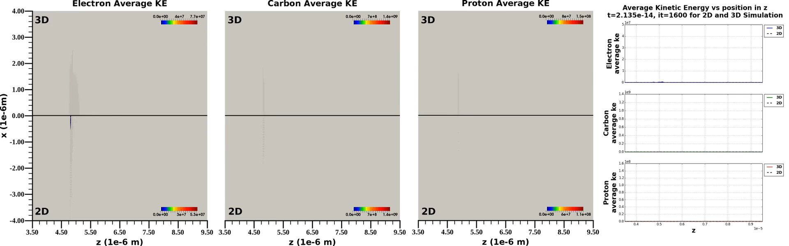
Analysis: Compare 3D and 2D simulation

Slide 10
Are 2D simulations good enough?
2D is qualitatively similar, but in 3D higher energies are reached, the beam propagates faster and further over the same time period.
Notes:
Maybe! But there are some substantial differences that suggest 3D is important in this application. in 2d beam is narrower and nearer the source, you may not be able to do accurate targeting or device design using 2d sims.

Slide 11
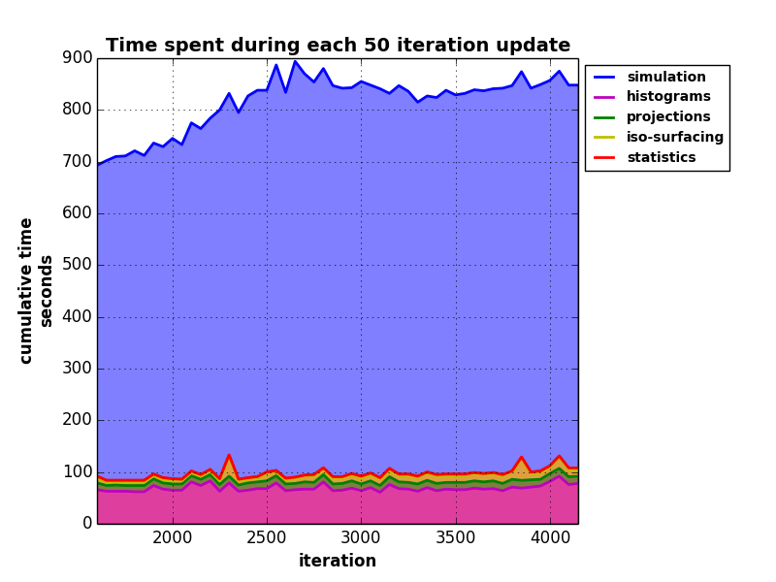
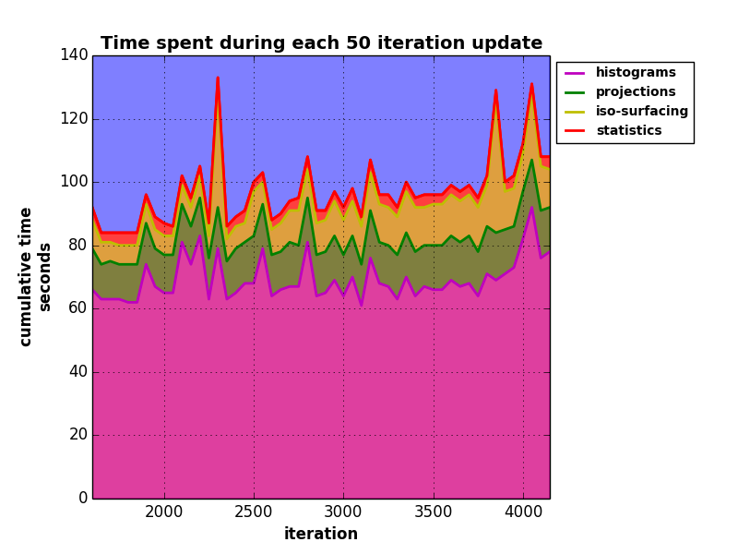
Performance
Notes:
this shows times from the 3d run of the simulation (big blue) and
12 histograms, 18 projections, renderings of 2 fields (den and ke) 20 iso-surface values with an alpha ramp
figure on the right is zoom in of fig on left
insitu is not free but not so bad relative to the sim either.
getting rendering to that point was a ton of work!

Slide 12
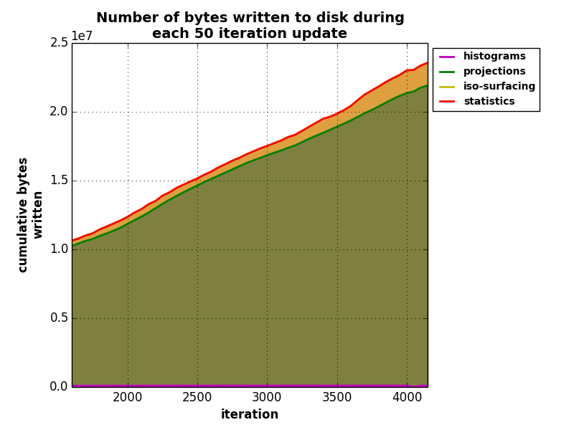
What about I/O?
Category | Actually written to disk
histograms | 4.48984 MB
projections | 795.969 MB
iso-surfaces | 40.7662 MB
statistics | 3484 b
total | 841.228 MB
To do this post process we would have written 3.2 TB to disk to capture the minimum amount of data to do the same analysis.
Insitu bought us a 4033 times reduction in I/O.
Notes:
this shows times from the 3d run of the simulation (big blue) and
12 histograms,
18 projections
renderings of 2 fields (den and ke) 20 iso-surface values with an alpha ramp
the amount of the projections increases because its easier for zlib to compress early in the sim, particles are concentrated in the sheet, the rest of domain is empty.

Slide 13
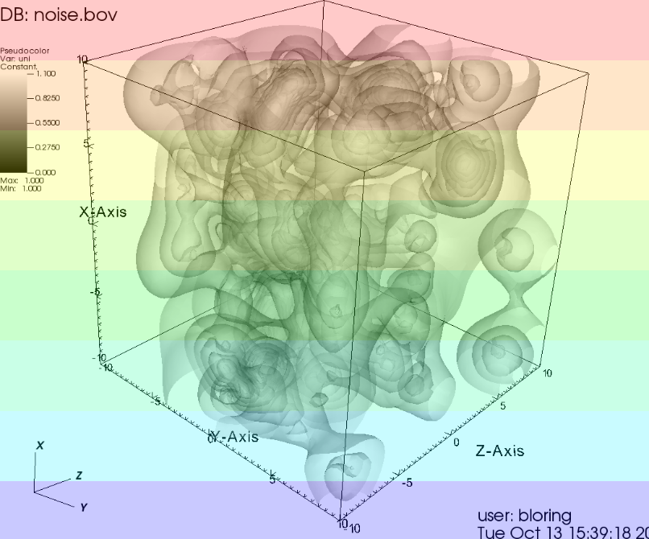
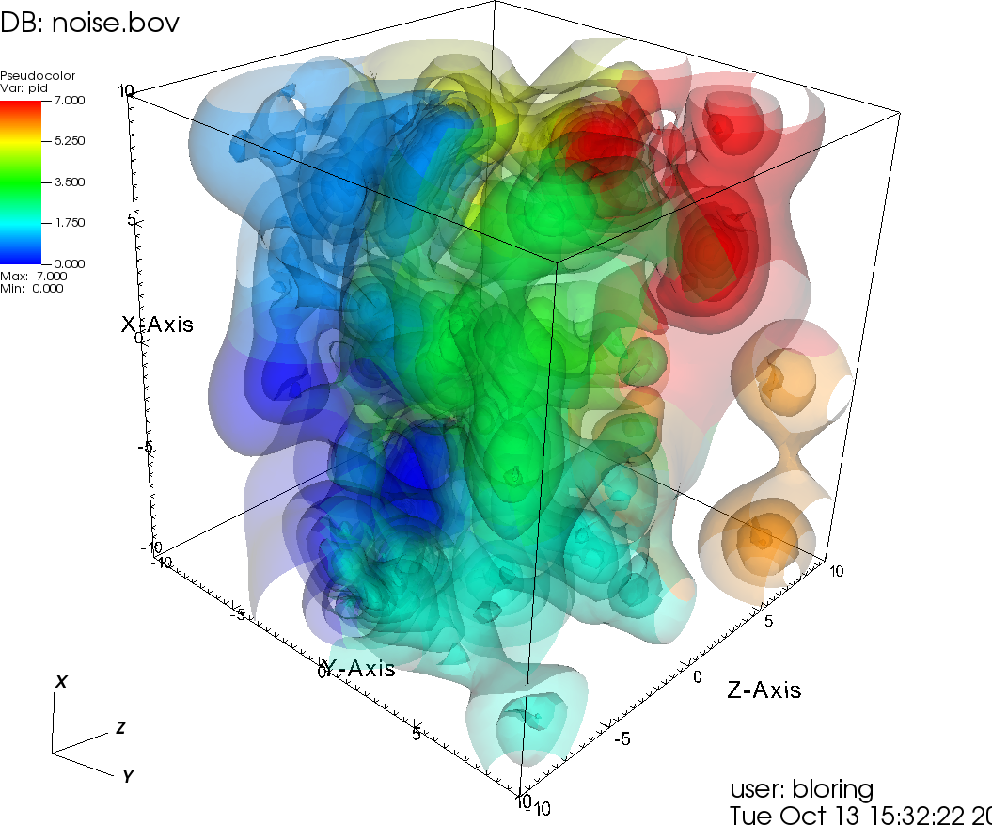
Translucent rendering performance
Before:
Global redistribution of data onto screen space tiles, followed by local sort
We implemented:
CPU based alpha blend and depth compositor
Ordered comp, SIMD, threads, overlap communication, minimize data movement and comm
Notes:
these mostly target transparent rendering.

Slide 14
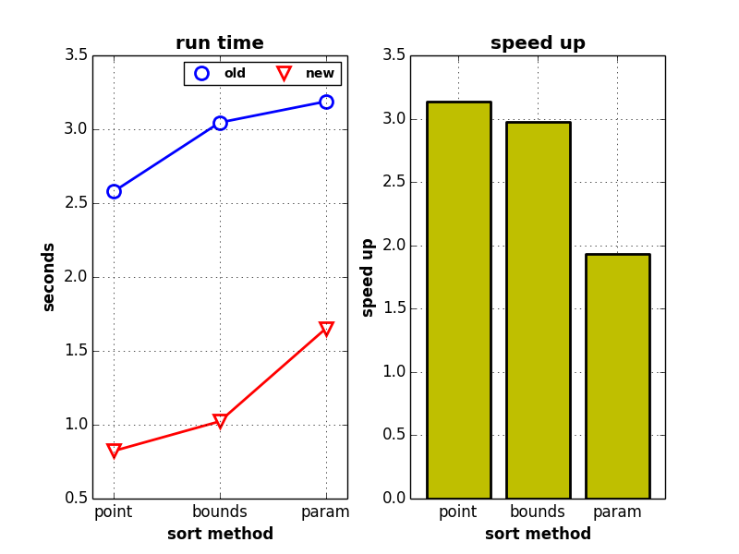
Improvements to VTK
vtkDepthSortPolyData
transfrom GetCell to GetCellPoints. Building the cell is expensive and we only need points to determine the depth. We can also then access the points in place.
transform qsort to std::sort. Comparisons in std::sort get inlined.
use templates to deal with point types instead of going through virtual GetValue API
restructure bounds computations so that it can be vectorized by the compiler.
Allocate the exact amount of memory for the output and build the output without using virtual API
vtkPolyData
inline the non-virtual overload of GetCellPoints.
avoid virtual API in BuildCells
add a NeedToBuildCells to check that fast API can safely be used

Slide 15
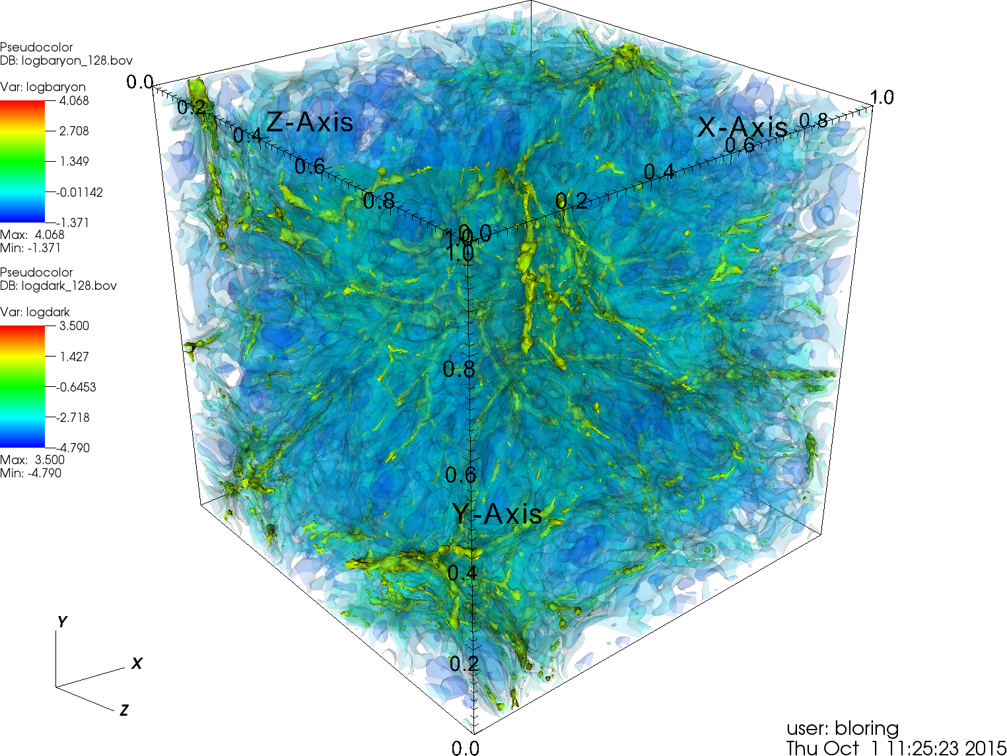
Workstation load
256^3 cosmology dataset
8 cores
Render Mesa or NV GTX GPU
1 opaque iso-surface
10 translucent iso-surfaces
camera is rotated in ½ deg increments
average time over 20 frames

Slide 16
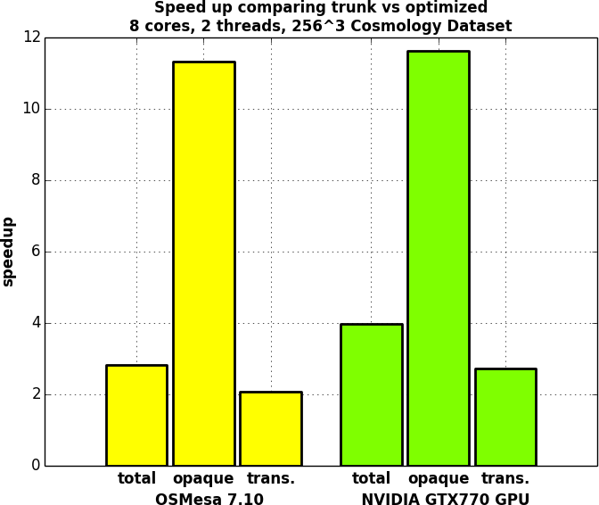
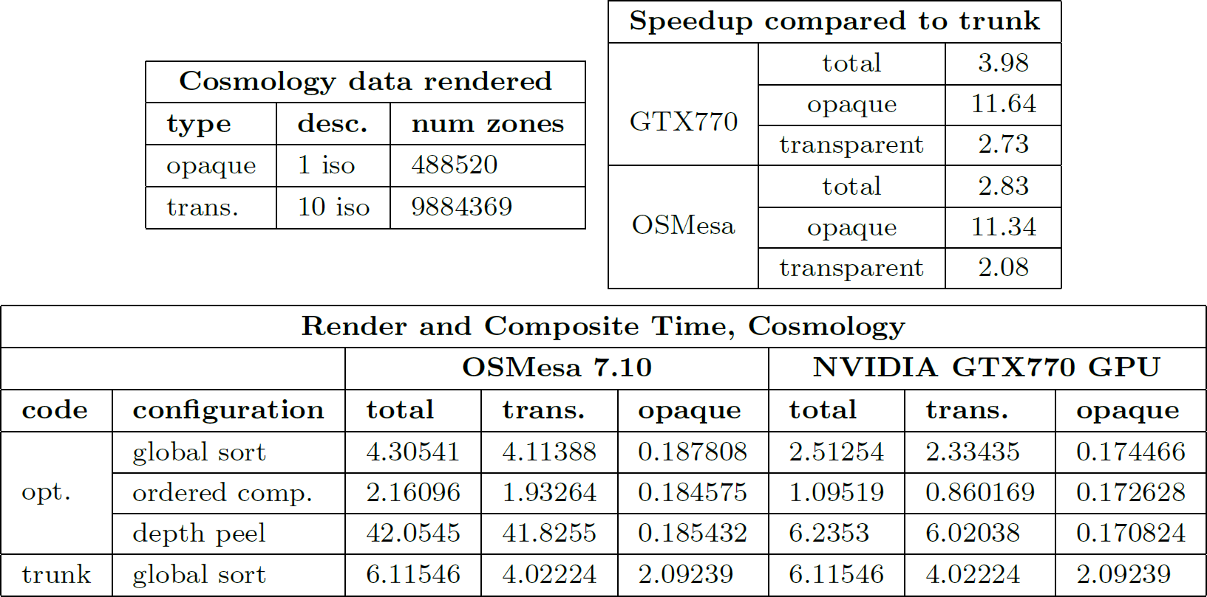
workstation results

Slide 17
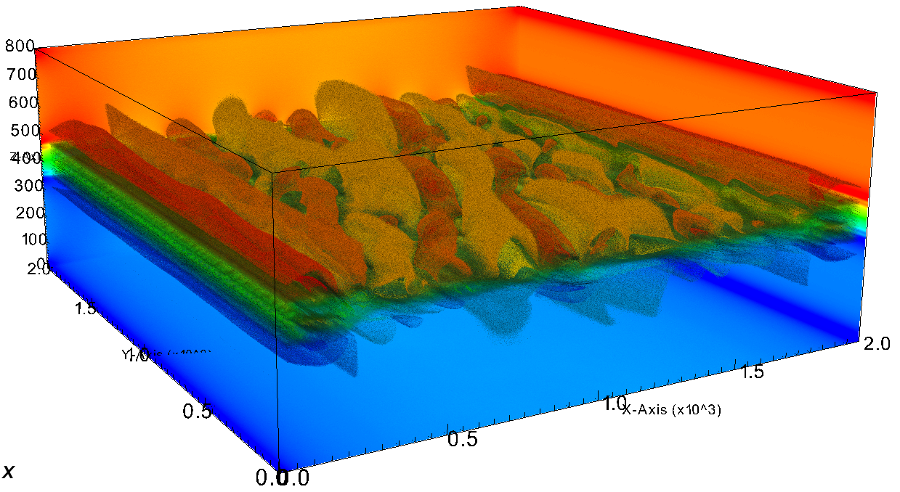
HPC work load
2000^2 x 800 plasma dataset
512 cores on Edison
3 opaque slices
20 transparent iso-surfaces
camera is rotated in ½ deg increments
average time over 20 frames

Slide 18
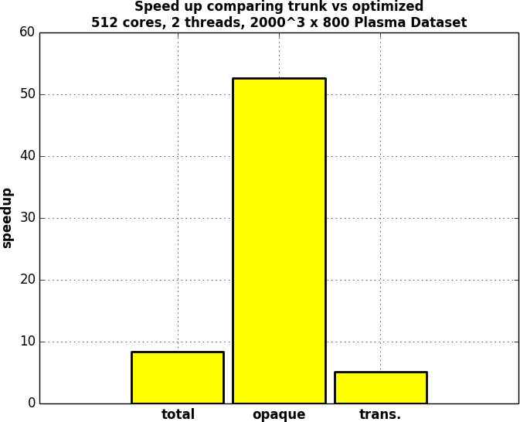
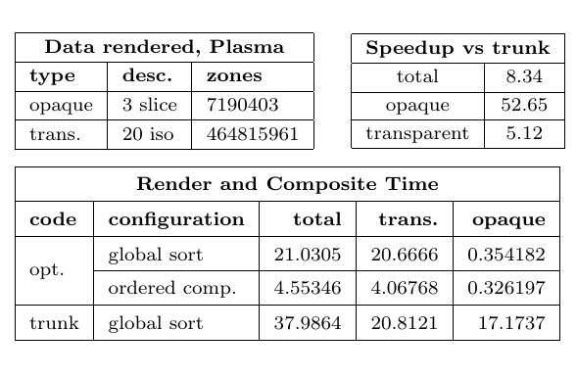
HPC work load result

Slide 19
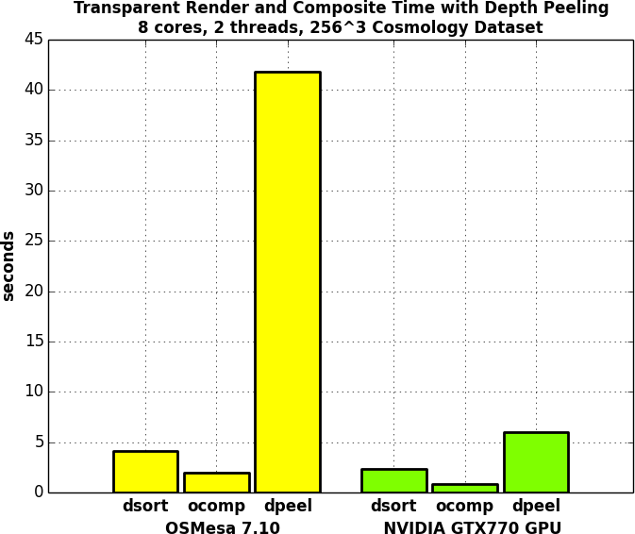
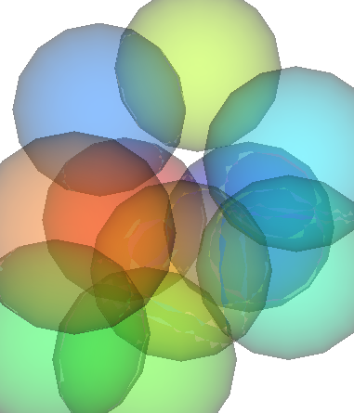

Using VTK’s depth peeling
It’s much slower than other opts
you do get a correct result
maybe better in VTK w GL2?
depth sort
depth peel
Notes:
these mostly target transparent rendering.

Slide 20
Conclusion
With post process analysis if you could get your images out in your work day it was “fast enough”
With insitu analysis we are under intense scrutiny from the science community. we have to have efficient, fast and reliable code
Working in layer between sim and vis provides opportunities for optimization and efficiency
Need more auto tuned rendering algorithms
Many opportunities to improve existing code. Profile it.
Don’t forget -O3 –march=native –mtune=native

